Slide 1
Today’s Drake Student – Using What We Know
Drake Symposium 2019

Slide 2
Discussion Framework

Slide 3
Degree trends

Slide 4
National Trends
Notes:
KS Note: consider the line at the top of the slide as a cue: Student move to Health and Engineering, away from Education and Humanities. This has some important implications for Drake given our portfolio of programs.

Slide 5
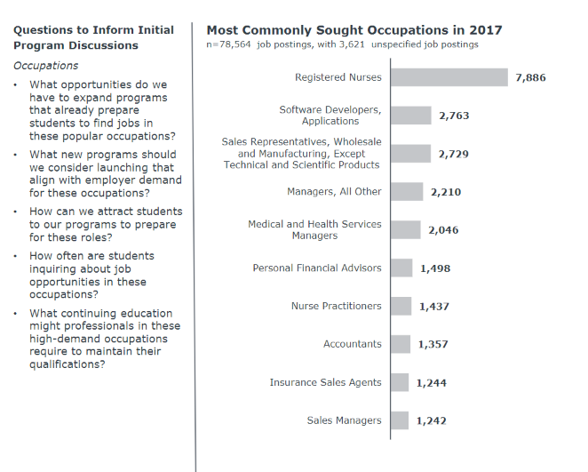
Iowa Workforce Outlook in 2017
Notes:
In connection with the previous slide regarding national trends here we take a look at the Iowa Workforce needs.
Growth: health fields, technology, business; decline: humanities, education employers are hiring. (SH)
KS note: Consider the Iowa workforce needs in the context of the previous slide (growth: health fields, technology, business; decline: humanities, education)

Slide 6
Drake Completion Trends
Notes:
Orientation is difficult to read – would likely switch to horizontal orientation
Think about reducing the number of programs presented to focus on the main point (highest # conferred)
May want to mimic format for National Trends with only presenting 17-18 data (not sure that the three year trend is the purpose here). If the purpose is to look at programs with growth and decline in the past three years then I'd split the group to present that way (+ business, - education) in separate slides.
Where are Drake trends. Drake's 17-18 data shows that our undergraduate degrees are inline with National trends. (SH)
In that our top majors continue to
KS note: You could simply ask the group to consider the national trends in degree completion, the Iowa trends in workforce needs, and the alignment with Drake's top completions. You could even invite the group to comment on what they notice (and then fill in if they don't name the points that you've identified). Making it more interactive on this slide might open up good dialogue with the group and keep the presentation energy up.

Slide 7
Drake Top Majors
Notes:
Let's simplify with 14, 16, 18 data
Drake's top majors show us that Drake continues to have high student interest in areas that align with the National trends. (SH)

Slide 8
New Majors
National Data
Drake
Notes:
Not sure I would include ENS as new major.
Two of Drake's new majors, Data Analytics and OT, not only align with the National trends but they are experiencing fast growth. (SH)

Slide 9
Curricular Complexity

Slide 10
Notes:
Notice the prolific growth in students with two or more majors from Fall 2006, noting that our undergraduate student population was largely the same (declined by almost 80 students during that window; 2913 in 2006 vs. 2834 in 2018)

Slide 11
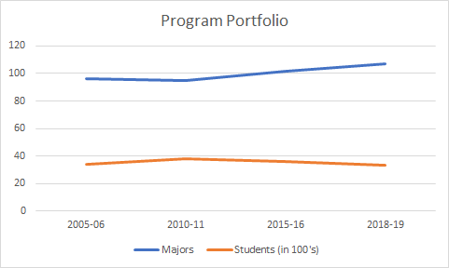
Notes:
Here is a look at the number of undergraduate majors compared to the number of undergraduate students (in 100's). As the institution thinks about adding curricular programs in an effort to attract more students, there needs to be a balancing conversation around overall portfolio and sustainability.

Slide 12
Declining demographics

Slide 13
National Data

Slide 14
State Data

Slide 15
National Data

Slide 16
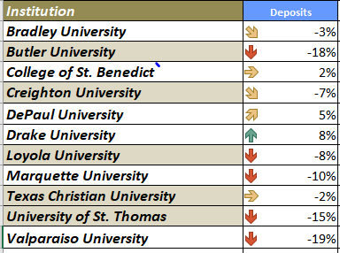

Slide 17
Forecasted Growth Regional Four-Year Institutions 2012-2029

Slide 18
Changing demographics

Slide 19
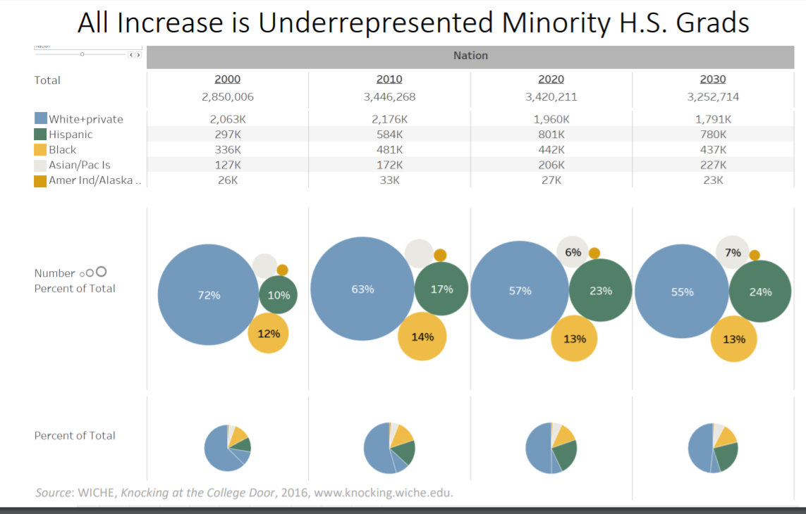
Notes:
Here we see an increase in the number and percentage of students of color in future high school graduating classes, with white students shifting from 63% in 2010 to 55% in 2030. Notice the greatest increase in Hispanic students represented by the green circle (as a percentage).

Slide 20
State Data
Notes:
Zooming in to Iowa, here is a comparison between 2017 and projections for 2029. We see a similar pattern with a decline in the number of White students, growing percentages in Black and Asian American. Iowa has a distinct pattern of a decline in Hispanic. Note that Drake's recruitment territory is much broader than Iowa. Regardless, we will see a changing racial/ethnic portfolio in the future.

Slide 21
Drake Undergraduate Profile
2016
2018

Slide 22
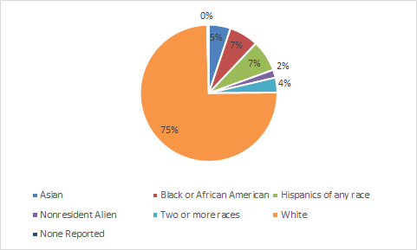
2019 Entering FY Student Profile

Slide 23
Change the Conversation

Slide 24
Discussion Framework

Slide 25
Strategic Enrollment Growth

Slide 27
1st Generation Trends (FLA)
2014 – 14%
2015 – 14%
2016 – 10%
2017 – 13%
2018 – 13%
2019 – 13%

Slide 28
NSSE 2019 Students with Disability
First-year: 18% diagnosed with any disability or impairment
64% mental health disorder
27% learning disability
9% disability not listed
7% mobility impairment
5% sensory impairment
Senior: 16% diagnosed with any disability or impairment
72% mental health
36% learning disability
11% disability not listed

Slide 29
Drake Undergraduate Demographics

Slide 30
Drake EFR Demographics
Notes:
Insight regarding % for 2019 EFR:

